Slide 1
LCR and GNMA CMO Issuance
October 2015

Slide 2
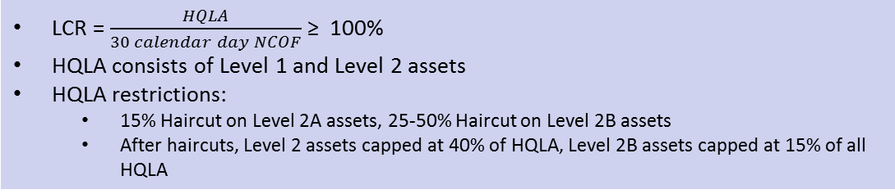
KEY TERMS
High-quality Liquid Assets (HQLA)
The Liquidity Coverage Ratio (LCR) aims to ensure that banks have an adequate store of high-quality liquid assets (HQLA) that can be easily and immediately converted into cash in order to meet liquidity needs for a 30 calendar day stress scenario. The stress scenario is specified by the appropriate regulatory bodies.
The Basel Committee calls for the LCR to remain at or above 100%, except during a pronounced period of stress, when liquidity can be temporarily drawn down.
HQLA assets are characterized as being more likely to generate funds (cash) without incurring large discounts in a “fire-sale” stress environment
Total Net Cash Flows (NCOF)
Total expected cash outflows minus total expected cash inflows in the specified stress scenario for the subsequent 30 calendar days
Liquidity Coverage Ratio (LCR)
LCR = $\frac{HQLA}{30 calendar day NCOF}$ ≥ 100%
HQLA consists of Level 1 and Level 2 assets
HQLA restrictions:
15% Haircut on Level 2A assets, 25-50% Haircut on Level 2B assets
After haircuts, Level 2 assets capped at 40% of HQLA, Level 2B assets capped at 15% of all HQLA

Slide 3
CATEGORIES OF HQLAs
Assets are considered to be HQLA if they can be easily and immediately converted into cash at little or no loss of value. The liquidity of an asset depends on the underlying stress scenario, the volume that needs to be sold, and the time frame involved. HQLA assets are expected to more or less retain their liquidity (i.e., not suffer from a substantial price discount) even in a fire-sale stress scenario.
HQLA assets must be unencumbered -- free of legal, regulatory, contractual, or other restrictions on the ability of the bank to liquidate, sell, transfer, or assign the asset.
HQLAs cannot be pledged to secure, collateralize, or credit-enhance any transaction, nor be designated to cover operational costs (such as rents or salaries).
HQLA DEFINITIONS
Level 1
Cash (Coins and banknotes) Central bank reserves, including required reserves, to the extent that central bank policies allow them to be drawn down in times of stress Marketable securities representing claims on or guaranteed by sovereigns, central banks, multilateral development banks, or other public sector entities, if they are assigned a 0% risk weighting under the Basel II framework and meet other qualifying conditions (U.S. Treasuries, GNMA MBS)
Level 2A
Marketable securities representing claims on or guaranteed by sovereigns, multilateral development banks, or other public sector entities if they been assigned a 20% risk weight under the Basel II framework and meet certain other qualifying conditions (FN/FH MBS) Corporate debt securities, including commercial paper, and covered bonds that have received a minimum AA- credit rating or the equivalent, if they have not been issued by a financial institution and meet certain other qualifying conditions
Level 2B
RMBS where the underlying mortgages have an average maximum LTV of 80% at issuance and where the securitizations are subject to “risk retention” regulations Corporate debt securities, including commercial paper, if they have not been issued by a financial institution , have received the equivalent of between an A+ and BBB- crediting rating, and meet other qualifying conditions. Common equity if it has not been issued by a financial institution, is exchange traded and centrally cleared, and meets other qualifying conditions

Slide 4
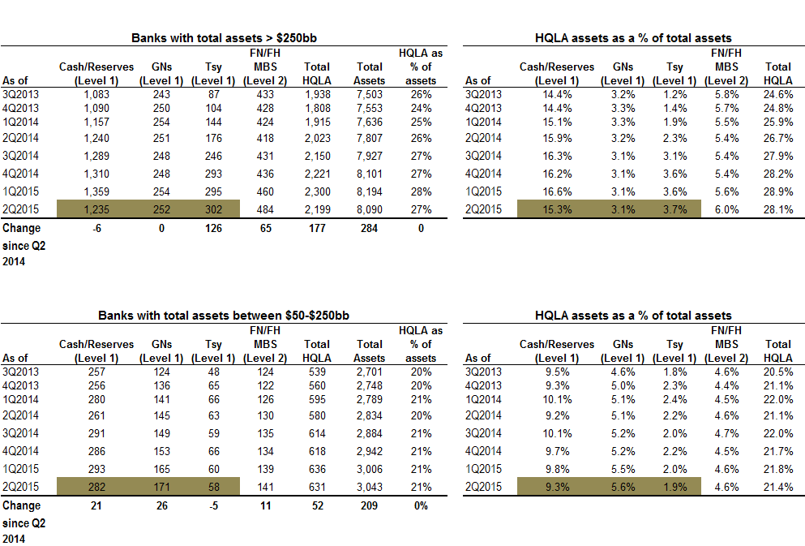
HQLA TRENDS
The tables show a time series of Level 1 (Reserves, GNMA MBS, and Treasuries) and Level 2 (Fannie Mae/Freddie Mac MBS) assets for banks with total assets more than $250bb and banks with assets between $50-250bb respectively. The total HQLA is calculated by applying a 15% haircut to Level 2 assets and adding them to Level 1 assets.
The tables show that:
Small banks have a significantly lower share of HQLAs
There has been no discernible difference in the behavior of large banks with respect to GNMAs since the implementation of LCR. However, small banks have been ramping up their holdings of GNMAs.
HQLA ASSET GROWTH FOR U.S. BANKS
Source: Citi Research

Slide 5
TRENDS IN EXCESS RESERVES
About 45-60% of Level 1 assets held by banks continue to be Reserves/Cash. As the figure shows, the U.S. domestic banking system currently holds more than $2.5 trillion in excess reserves. As the Fed starts to reduce its balance sheet over the next few years, the implication is that reserves will decline and need to be replaced by either Treasuries or GNMAs.
These GNMAs will likely correspond to short vanilla CMOs since they have to be reasonable cash-substitutes.
However, conventional wisdom holds that the Fed will not be able to reduce its balance sheet through sales (in order not to roil UST and MBS markets) and will pursue a strategy that focuses on ceasing to roll securities as they mature and on raising IOER. In this scenario, reduction in excess reserves is expected to be gradual.
EXCESS RESERVES FOR U.S. BANKS
(January 2010 – September 2015)
Source: Citi Research

Slide 6
DISCLOSURES Important Notes
THIS DOCUMENT IS NOT AN OFFER TO SELL OR THE SOLICITATION OF AN OFFER TO BUY SHARES OF THE FUND. AN OFFERING OF INTERESTS WILL BE MADE ONLY BY MEANS OF A CONFIDENTIAL PRIVATE PLACEMENT MEMORANDUM AND ONLY TO QUALIFIED INVESTORS IN JURISDICTIONS WHERE PERMITTED BY LAW. PAST PERFORMANCE IS NO GUARANTEE OF FUTURE PERFORMANCE.
An investment in the Fund is speculative and involves a high degree of risk. The Fund will have substantial limitations on investors’ ability to redeem or transfer their shares, and no secondary market for the Fund’s shares exists or will develop. All of these risks, and other important risks, are described in detail in the Fund’s Confidential Private Placement Memorandum. Prospective investors are strongly urged to review this Confidential Private Placement Memorandum carefully and consult with their own financial, legal and tax advisors, before investing.
Portions of this document may contain commentary and/or data based on certain current assumptions by Cello Capital Management, LP(“Cello”), which are subject to change at any time, as well as Cello's internal complex calculations. If one or more of these assumptions or calculations is incorrect, the information contained herein may unintentionally be inaccurate.
Certain information contained herein may have been obtained by Cello from third parties. While Cello believes such sources are reliable, Cello has not verified the accuracy of such information and shall not be liable for any errors in such information or for any actions taken in reliance thereon.
Performance results referenced in this document are provided for an investor in Class A1a shares of Cello Fixed Income Master Fund, LP (the “Master Fund”). Unless otherwise noted. Performance reflects all income. Class A1a shares launched on January 1, 2012, and returns for periods prior thereto have been adjusted to reflect the management fees and performance allocations chargeable to Class A1a shares.
The Credit Suisse Fixed Income Arbitrage Hedge Fund Index is a subset of the Credit Suisse Hedge Fund Index that measures the aggregate performance of fixed income arbitrage funds. The Fixed Income Arb Index, which includes mortgage-backed securities, is part of Dow Jones Credit Suisse Hedge Fund Index. The Barclays U.S. Aggregate Index represents securities that are SEC-registered, taxable, and dollar denominated. The index covers the U.S. investment grade fixed rate bond market, with index components for government and corporate securities, mortgage pass-through securities, and asset-backed securities. The Credit Suisse All Hedge Index is an asset-weighted hedge fund index. The S&P 500 is an equity index based on the market capitalizations of 500 large US companies.
This document may also contain certain forward looking statements and projections. Such statements and projections are subject to a number of assumptions, risks and uncertainties which may cause actual results, performance or achievements to be materially different from future results, performance or achievements expressed or implied by these forward-looking statements and projections. Prospective investors are cautioned not to invest based on these forward-looking statements and projections.
This document may contain references to certain internal Cello procedures and policies which are subject to change at any time.
No information or material contained herein may be reproduced, transmitted, displayed or commercially exploited without the prior written consent of Cello. All rights are reserved.

